Slide 1

Sneha Wadhwa

Slide 2
2030
One in six people in the world will be aged 60 years or over.
Source: WHO

Slide 3
Age Tech
Notes:
This demographic shift is already creating profound wellbeing challenges

Slide 4
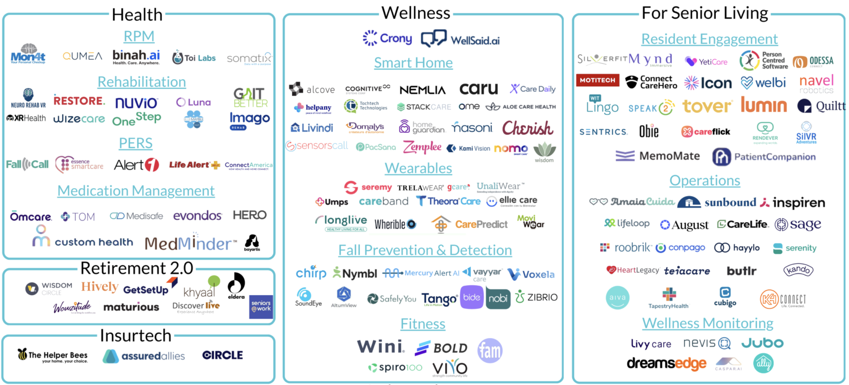





Age Tech
2025
Market Map
Source: https://thegerontechnologist.com/

Slide 5
Demographic Reality
Loneliness and social isolation are key risk factors for mental health conditions
1 in 6 seniors experience abuse
Approximately 14% of adults aged 70 and over live with a mental disorder.
Mental disorders among older adults aged 70 years or older account for 6.8% of the total years lived with disability for this age group.
Millions retiring in the next 5 years lack adequate support or planning
Source: WHO
Notes:
This demographic shift is already creating profound wellbeing challenges

Slide 6






The Disconnect - Market
What research says
What Age Tech delivers
Notes:
Age-tech currently delivers isolated solutions instead of integrated solutions that impacts their overall wellbeing.

Slide 7


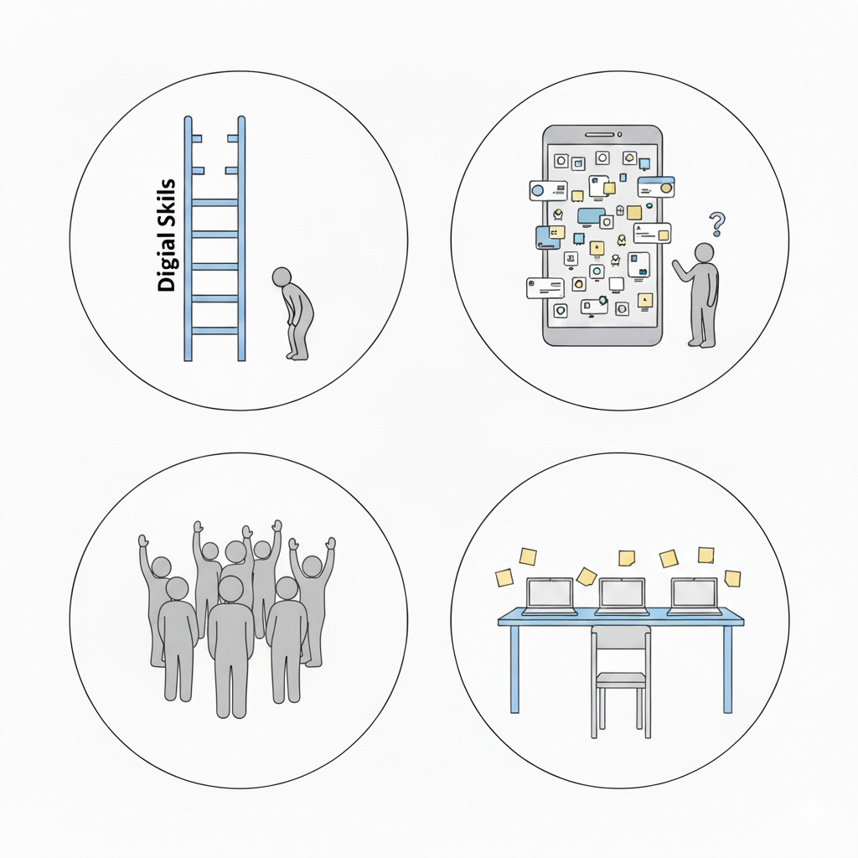
The Disconnect - User
2025
50+
Global data on digital readiness (ITU) 2023, shows persistent gaps in digital literacy among older adults.
AARP 2024 Tech Trends: 59% of adults say technology is not designed with their age in mind.
OECD, usability studies show that older users are often under-represented in testing and design processes, which leads to usability issues
AARP 2025 Tech Trends: 71% of adults are interested in tech support services for older adults

Slide 8
The Digital Divide: Created by Design, Not Capability
Barriers
Digital literacy assumed from the start
Inadequate onboarding processes
Rapid technology evolution without learning pathways
Ageism – self and industry
Critical finding
Older adults do not lack awareness or digital know how. They lack structured support to learn how to use it.
Result
A population systematically excluded from tools that could enhance their wellbeing—not because they cannot learn, but because the learning infrastructure doesn't exist.

Slide 9
So what designs do we need to close this gap?

Slide 10
Design Foundations for Aging-Inclusive Technology
Five Evidence-Based Big Ideas with Key Approaches for Creating Technology for Older Adults

Slide 11
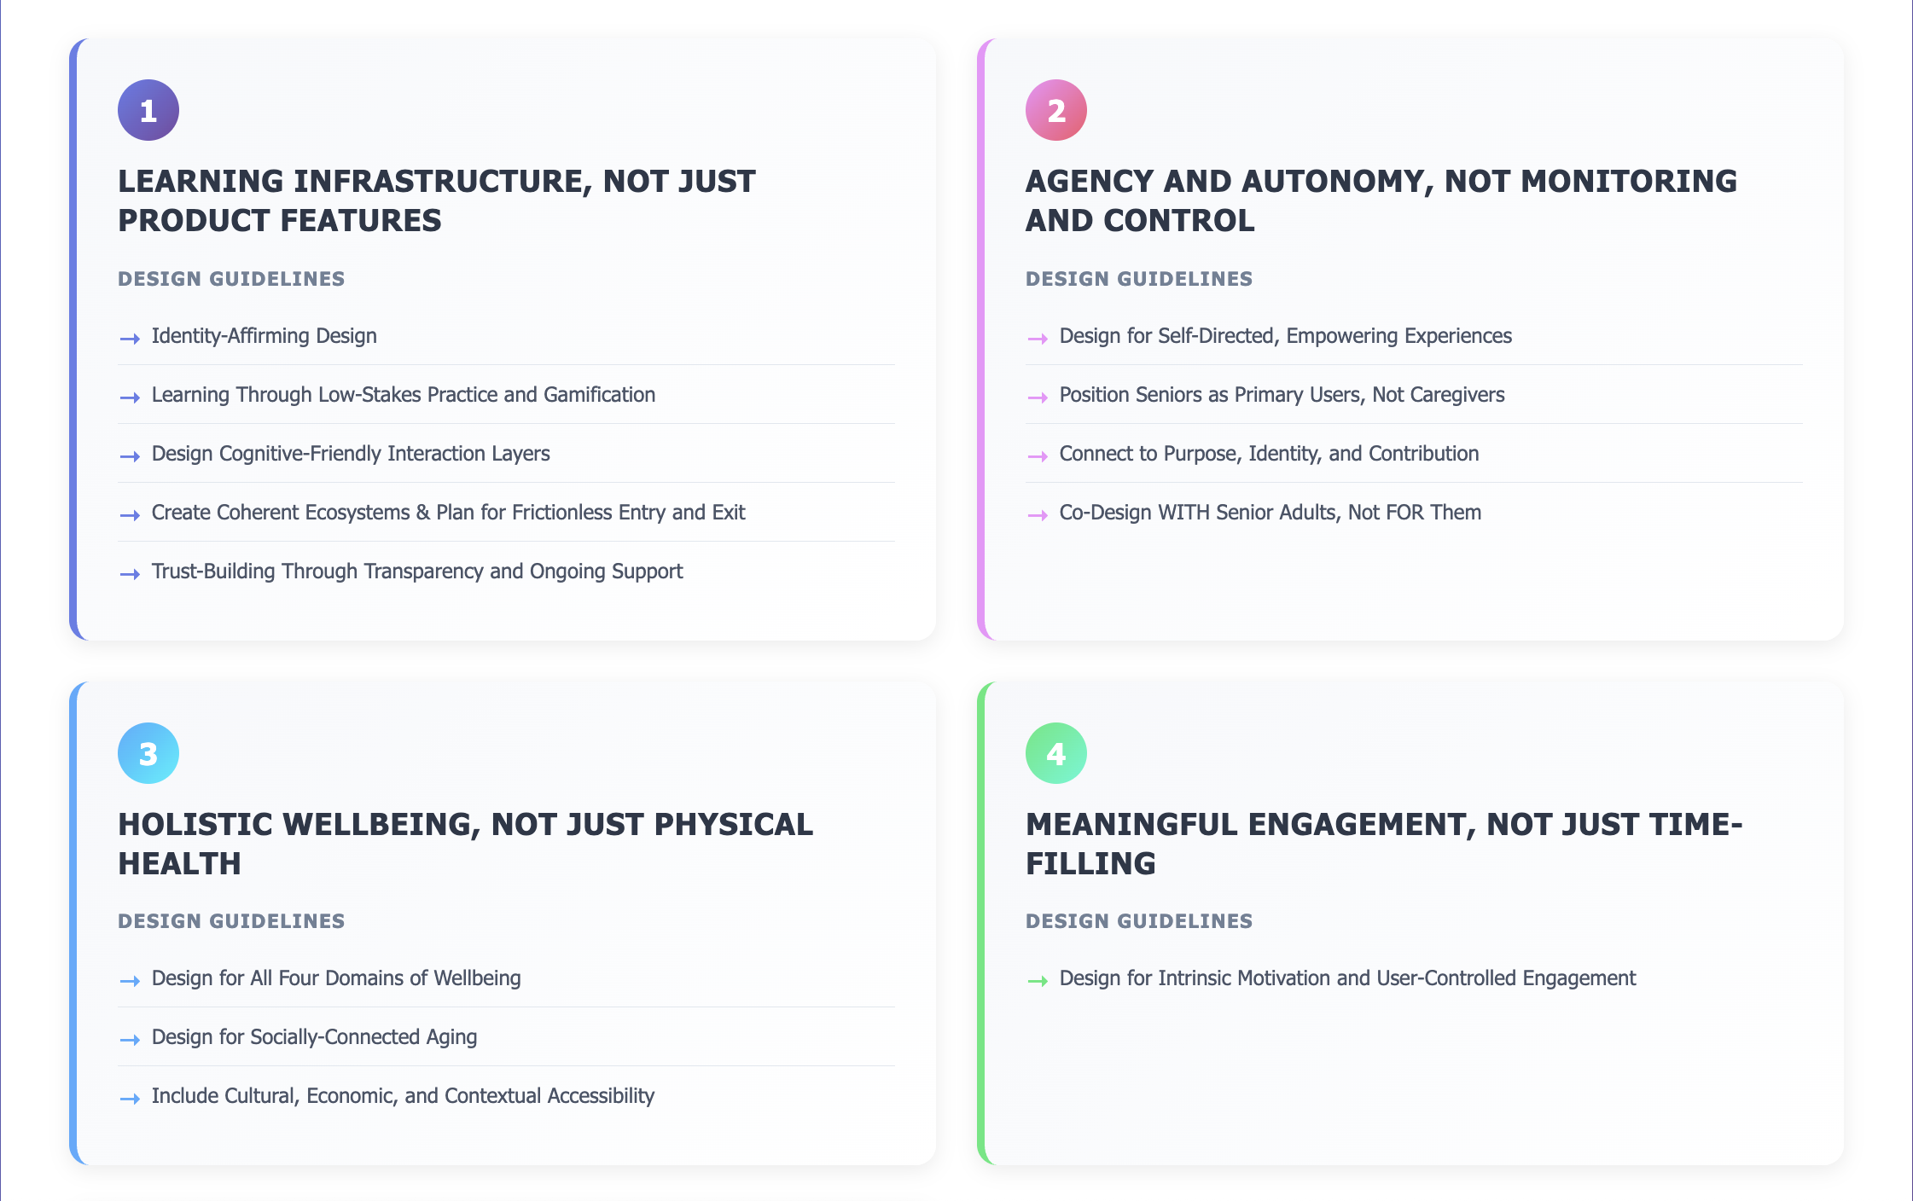
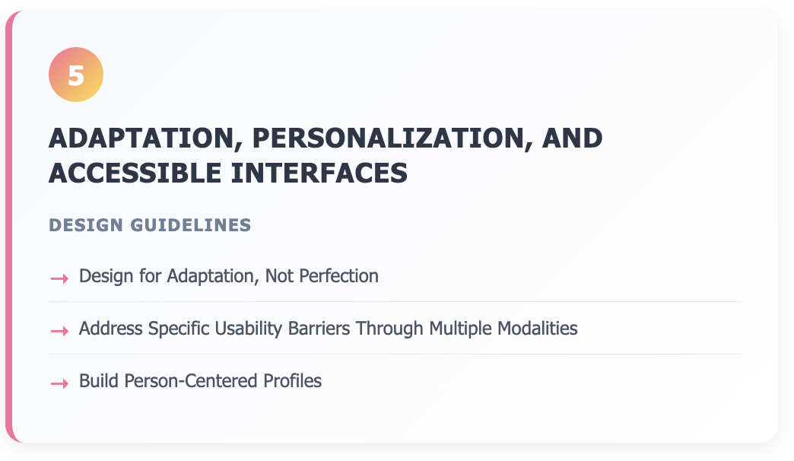
MVP 1: Design Foundations for Aging-Inclusive Technology
Notes:
Learning infrastructure – gives agency and autonomy – is focused on holistic well-being, drives meaningful engagement – and interfaces that are accessible.

Slide 12
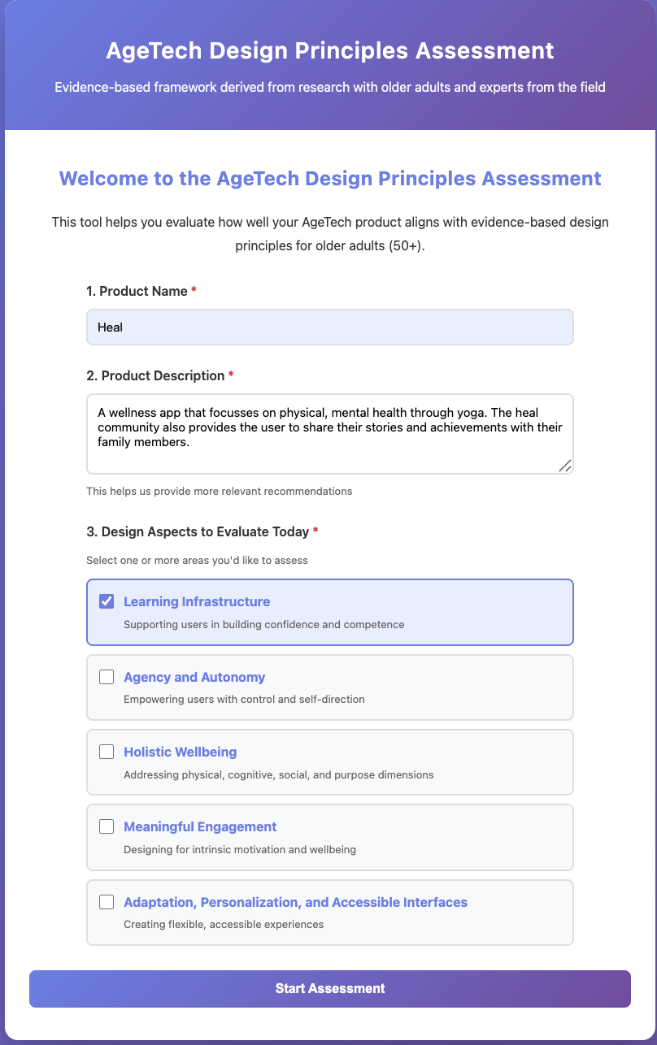
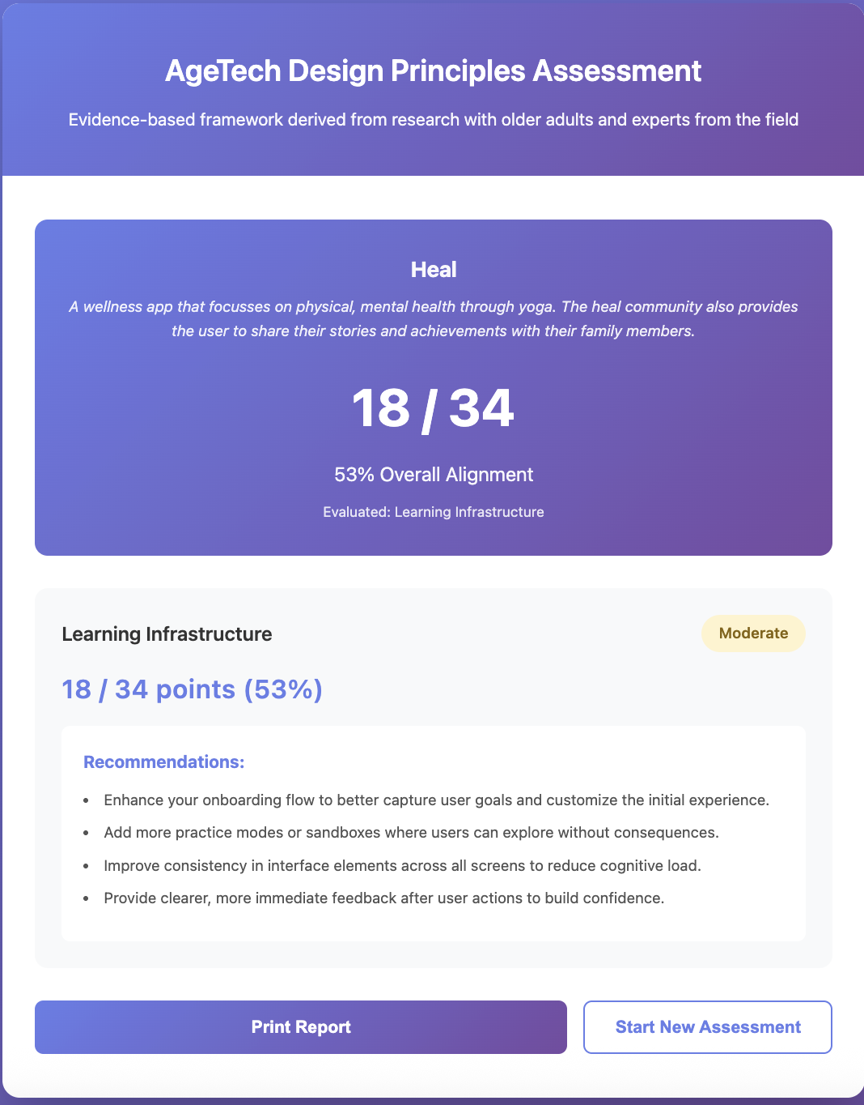
MVP 2: Reflective Tool to assess age-inclusive design quality

Slide 13
Designing the Missing Layer (empathy) in Age Tech
If products are co-designed with older adults and are based on the Design Foundation Principles then technology becomes learnable, usable, and supportive of aging, so older adults move from simply having access to tech to actually benefiting from it.

Slide 14
Thank You!

Slide 15
The Current State of Age Tech
Design Process
Products designed FOR seniors, not WITH them
Primary User
Caregivers positioned as main users
Product Focus
Health-domain dominated (fall detection, medication reminders, health monitoring)
Minimal meaningful co-design or participation
Senior voices systematically excluded
Seniors become passive subjects of monitoring
Contradicts values of independence and agency
Disease management rather than wellbeing support
Reactive rather than proactive approach

Slide 16
The Current State of Age Tech
Design Process
Products designed FOR seniors, not WITH them
Primary User
Caregivers positioned as main users
Product Focus
Health-domain dominated (fall detection, medication reminders, health monitoring)
Minimal meaningful co-design or participation
Senior voices systematically excluded
Seniors become passive subjects of monitoring
Contradicts values of independence and agency
Disease management rather than wellbeing support
Reactive rather than proactive approach

Slide 17
WELL-BEING
Physical well-being
Cognitive well-being
Social well-being
Physical Activity
Self-awareness
Outlook
Community Engagement
Faith
Diet
Social Support
Lifelong Learning
Financial Security
Source: Rowe, J. W., & Kahn, R. L. Successful Aging

